Slide 1
Eurovision
Jury and Public Trends
from 2016 to 2023

Slide 2
About the Project
Topics:
    Eurovision Results
Sites:
    Collection of Jury and Populace Voting (Kaggle)
    Collection of Populace Polling(Eschome)

Slide 3
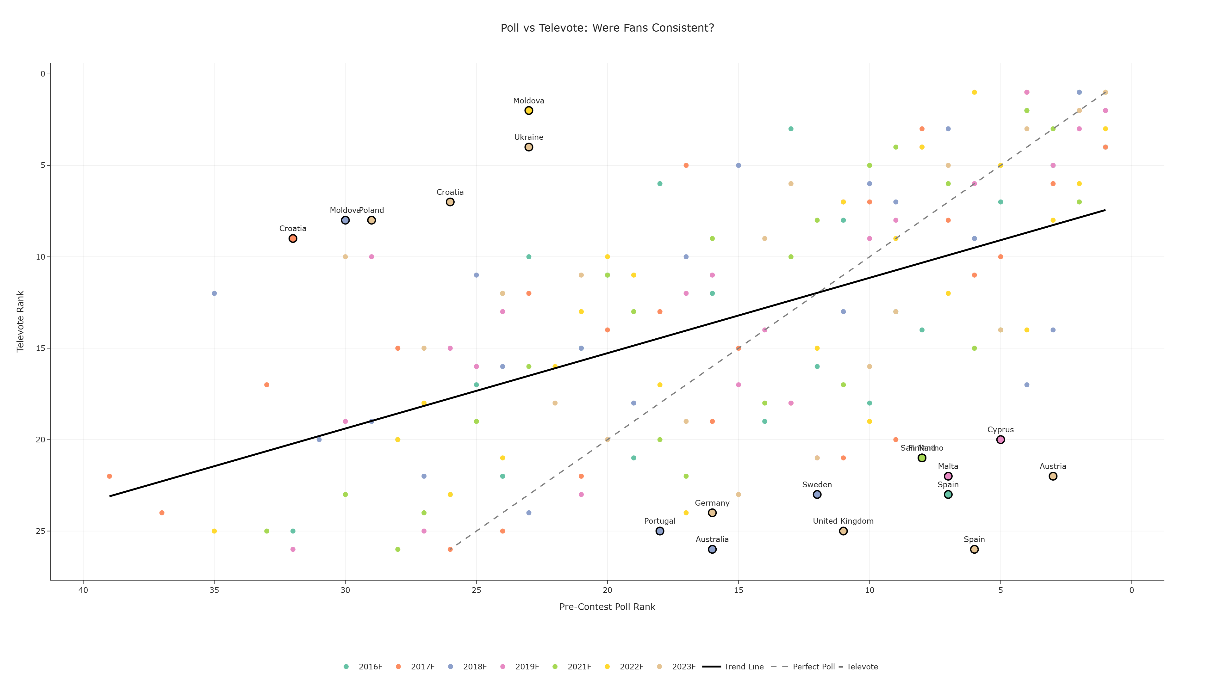

Slide 4
# | Data Attributes | Attributes Types | Visual Channel
1 | Poll Results
2 | Televotete
3 | Year

Slide 5
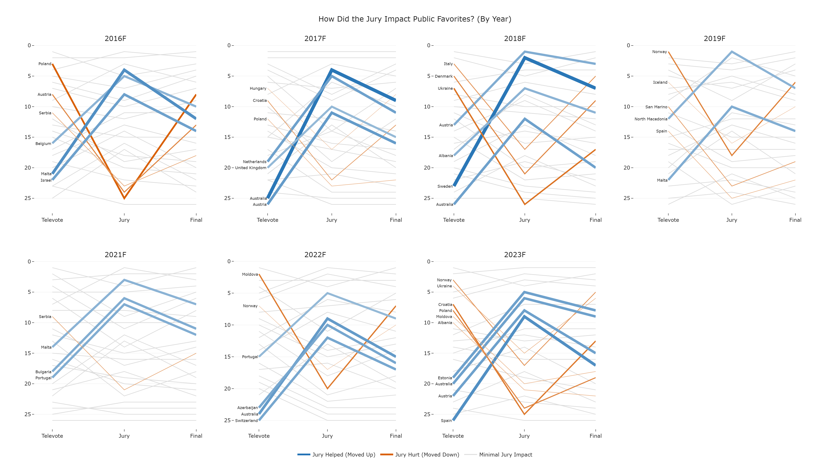

Slide 6
# | Data Attributes | Attributes Types | Visual Channel
1 | Jury
2 | Televotete
3 | Final
4 | Year

Slide 7
WorkFlow

Slide 8
Thank You For Your Attention
Mutua Fadhla Mohamed
SM3201434

